Slide 1
Join the Climathon movement, drive climate action

Slide 2
“Climathon is your opportunity to find solutions to create a cleaner, healthier, safer and more prosperous world”
Ebrahim Mohamed, Director of Education, Climate-KIC

Slide 3
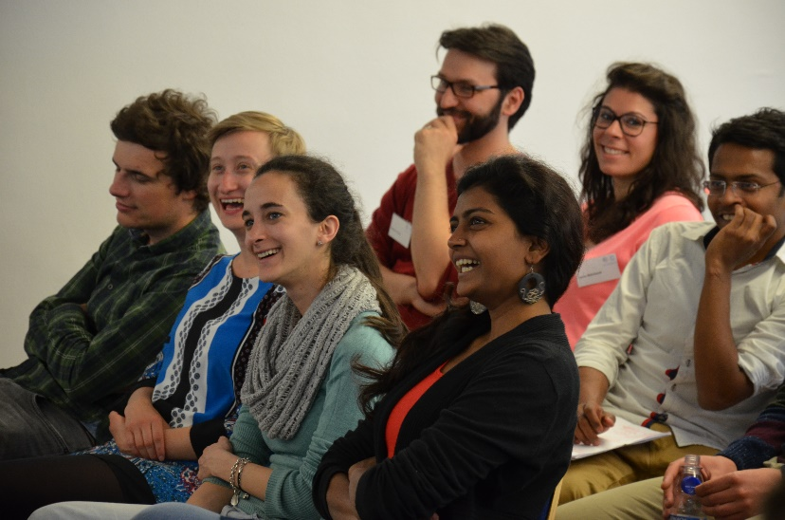
What is Climathon?
Climathon is a global 24-hour climate change hackathon which will take place simultaneously in major cities around the world on 27 October 2017.
It brings together the challenges of the world’s cities with the people who have the passion and ability to solve them. Climathon attracts innovators, entrepreneurs, students and professionals to create innovative solutions to cities climate challenges.
Notes:
The aim of Climathon is to bring together the challenges of the world’s cities with the people who have the passion and ability to do something about them.
Participants gather for 24 hours to engage in a climate-related problem solving workshop.

Slide 4
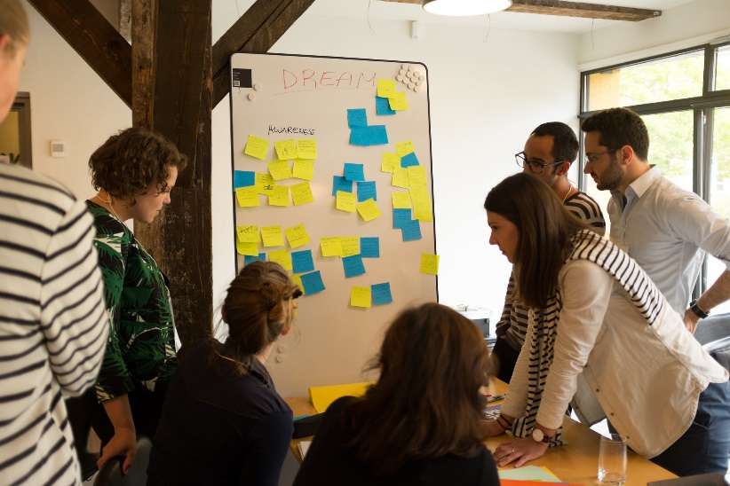
The Challenge
Each city sets its own local climate challenge that reflects what affects their urban life the most. Challenges can vary from air quality, water and waste management, and extreme weather events, use of city satellite data, etc.
Participants then tackle the set challenge for a full 24-hours, before pitching their ideas in front of relevant local stakeholders.
These ideas can develop into tangible sustainable solutions and businesses that address city climate challenges across the globe.
Notes:
Each city sets up its own local climate change challenge reflecting what impact their urban life most.
These challenges include urban planning, infrastructure, housing and water/waste removal, use of city satellite data etc. 2015 examples: flood risk - Boston, energy efficiency - Frankfurt, air quality – London.

Slide 5
Become a Climathon city host
Engage your citizens to take real climate action today!
How will you benefit from hosting a Climathon:
Crowdsourcing local ideas to solve climate challenges in your city
Engagement of local students, entrepreneurs and innovators
Forge strong links between local businesses, academia and public bodies
Empower and showcase your local communities climate action across the globe
Engage with global partners through Climate-KIC

Slide 6
Become a Climathon city host
Engage your citizens to take real climate action today!
Climate-KIC will support you with:
Climate-KIC Global Climathon branding and marketing tools
Climathon event webpage for each Climathon city
Online registration portal for participants
Climathon handbook and event planning guide
Communication toolkits: online marketing materials, customizable flyers and posters etc.
On-going advisory forum to plan and run your Climathon
Notes:
Climate-KIC will support city hosts throughout the Climathon process from recruitment of participants through to on the day support throughout the 24 hour global Climathon.

Slide 7
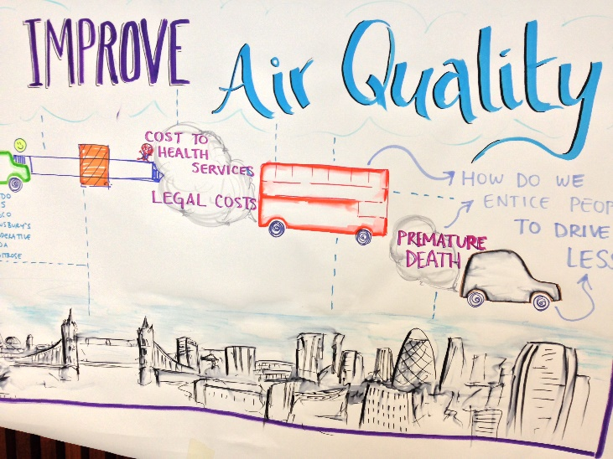
Create your challenge
A good challenge will:
Address a local climate change problem
Provide data sets or interesting information for hackers to work with
Have an engaged set of stakeholders who have an interest in solving the challenge and will support the Climathon with input, data, and mentoring
Notes:
Each city sets up its own local climate change challenge reflecting what impact their urban life most.
These challenges include urban planning, infrastructure, housing and water/waste removal, use of city satellite data etc. 2015 examples: flood risk - Boston, energy efficiency - Frankfurt, air quality – London.

Slide 8
Local responsibilities
Each location that is hosting a Climathon must provide the following:
A venue for the 24 hour event
Coaching to accompany the Climathon
Agenda with speakers, coaches
A city challenge, or the broad challenge of climate change in cities
Data from the city as hacking stimulus
Local prize for the winning team (meeting with respective decision makers, coaching, incubation etc.)
Notes:
The Climathon will take place in a 24 hour period. Each location will then start at their 09:00 time respectively. By the time all the hacks have started the American locations and the Asia locations will still be working at the same time.

Slide 9
Become a Climathon Innovator
Create real solutions to your city’s climate challenge, take action in your city
Climathon offers participants the chance to create real solutions to their city’s local climate challenge and take action in their city. Participants of Climathon also benefit from:
Helping to make their city more resilient to climate change
Networking with local leaders from academia, business and public authorities
Developing their skills in public speaking, innovative thinking, prioritisation and exploring new tools and methodologies
Joining forces with other like-minded entrepreneurs and innovators
Generating ideas and solutions to climate change that can become real-life businesses
Becoming a part of a global community working together to take climate action!
Notes:
Participants can register their interest in taking part in local Climathon challenges until 15 October 2017.
We encourage participants to join with or without a pre-existing idea, and with or without a team.
Teams will be set up on the day, and work together on the challenge, develop their ideas during the 24 hours.

Slide 10
Recruitment
Recruitment can be targeted at:
Students with various backgrounds
Citizens
Young professionals
Entrepreneurs
Designers, creators, and geeks!
We will provide you with tools to help you to market the Climathon locally
Notes:
Recruitment for the Climathon will take place locally with central support.
A web page with an application form is provided by Climate-KIC. We will also provide you with marketing materials to promote your Climathon locally.
Locally you, as the organiser, must reach out to your community to encourage applications and build interest. For a free event, about 65% of those who register will actually show up. This number is very consistently seen across events.
So cap registration at 150% of your actual maximum capacity.
We will provide marketing tools to help you recruit your climathon locally.

Slide 11

Timeline

Slide 12
Contact us
If you have any queries about the Climathon please contact:
Climathon Manager Orsolya Barna climathon@climate-kic.org

